Slide 1
HINTS5C5 – Data Analysis for online medical record access
Sheethal Sridhar

Slide 2
Base Model
Usage of Internet to
Seek Health Info
Health Care-Info About
Visiting a Doctor
Medical Records
Overall Patient Health
& Physical Activity
Personal Health

Slide 3
Data Preparation

Slide 4
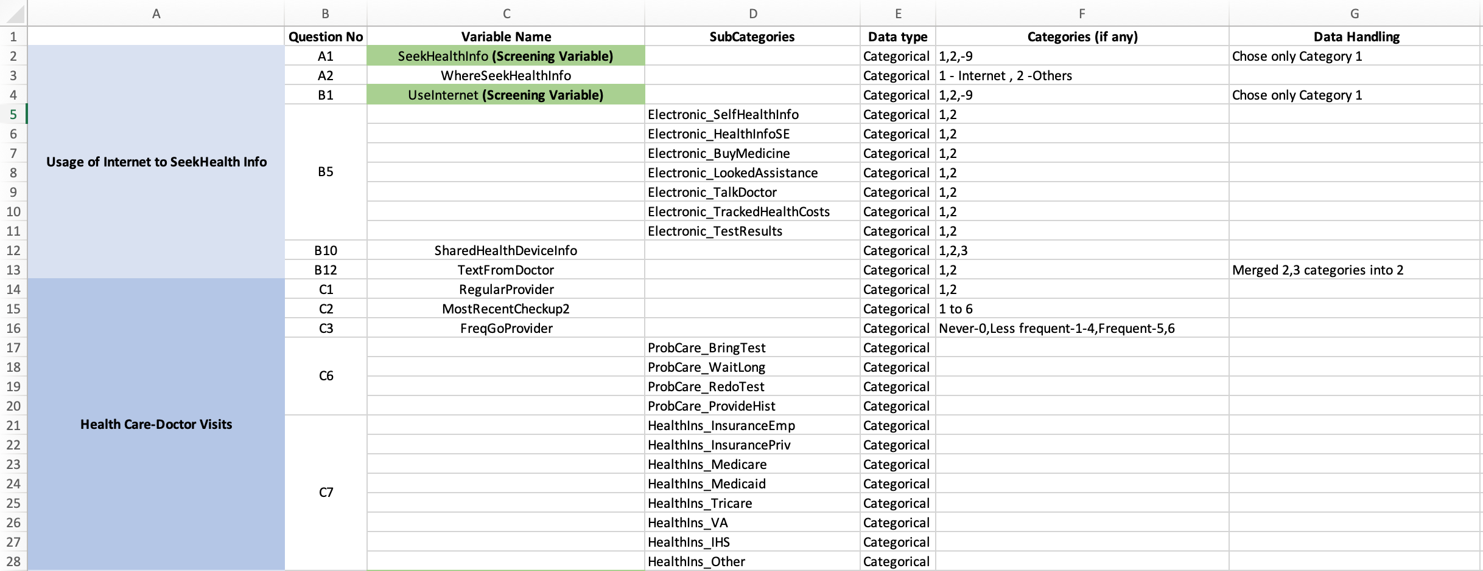

Slide 5
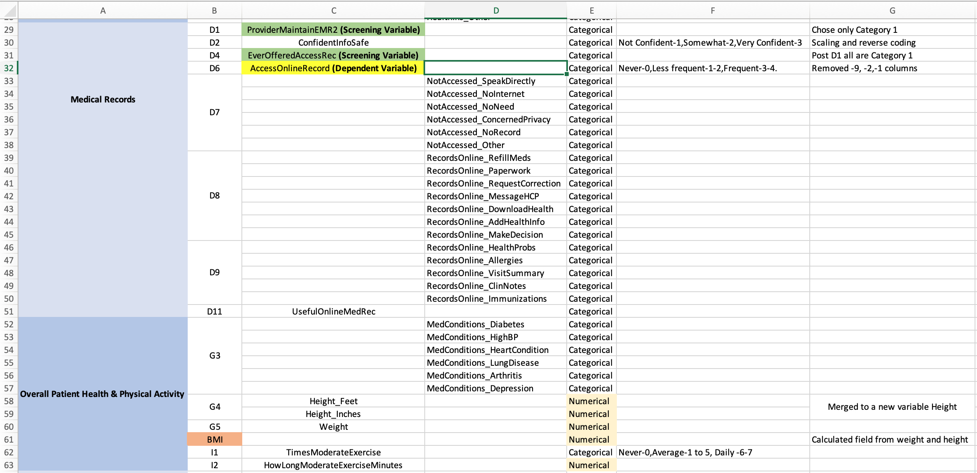

Slide 6
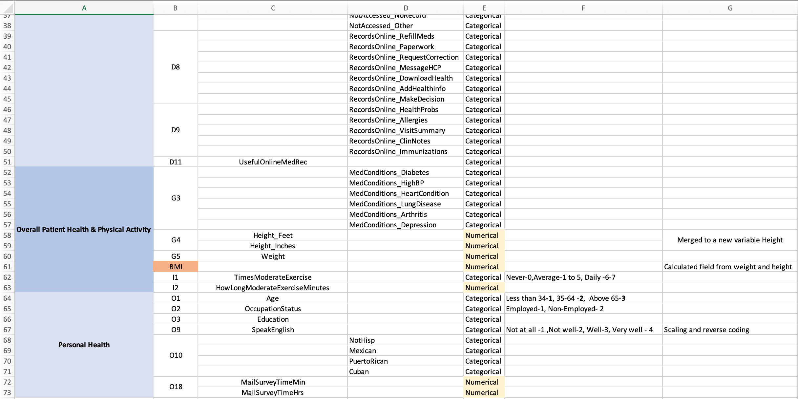

Slide 7
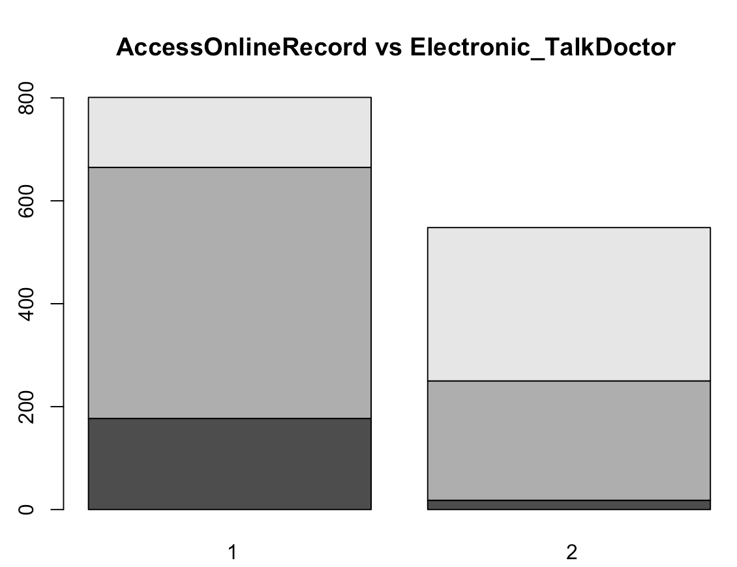
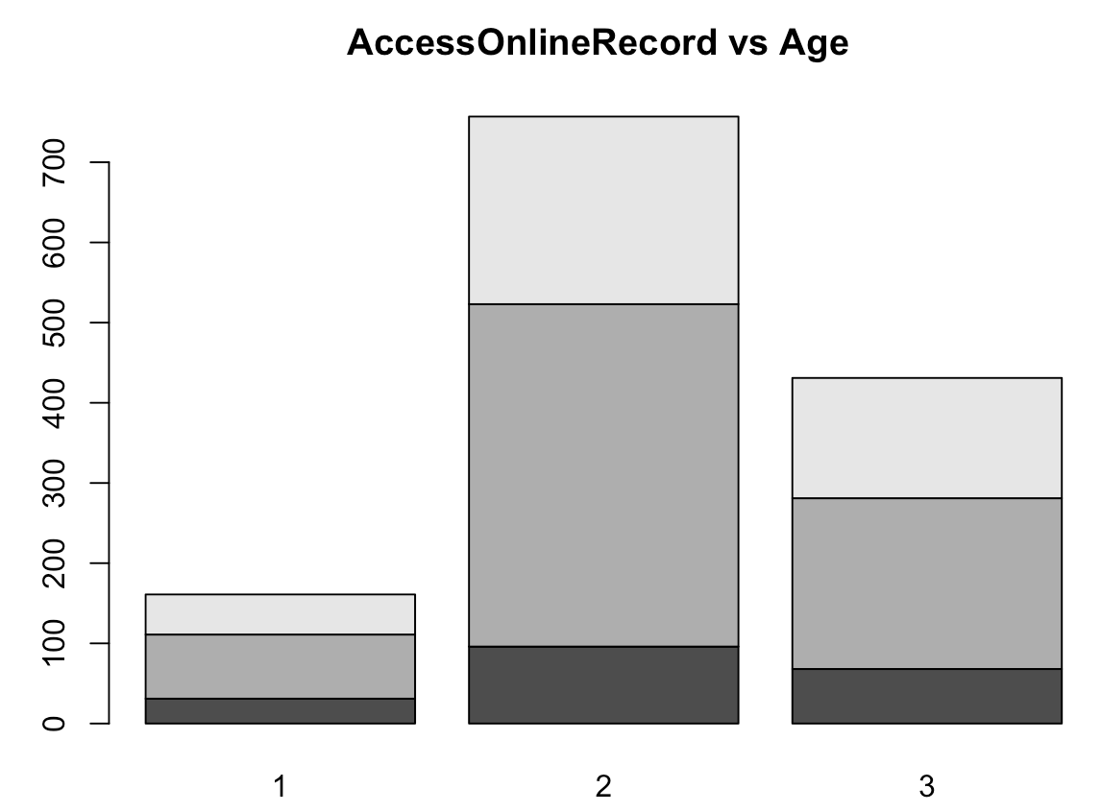
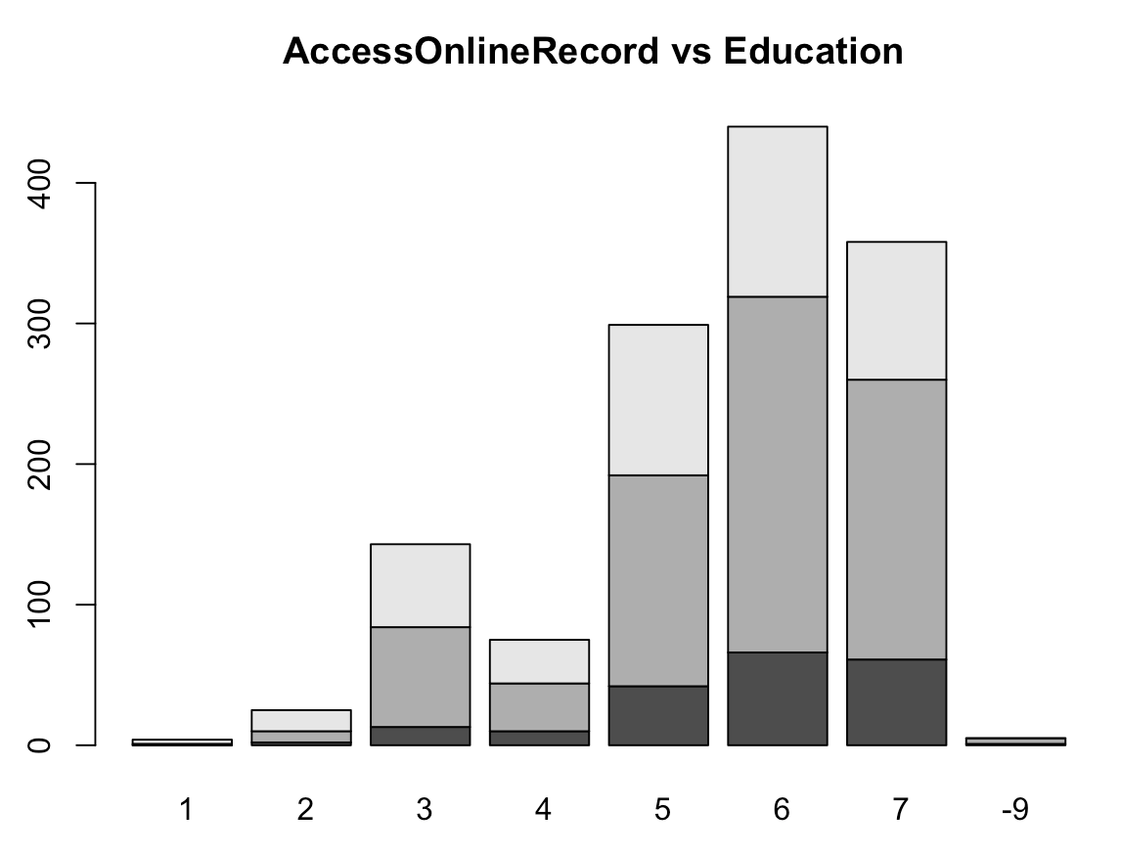
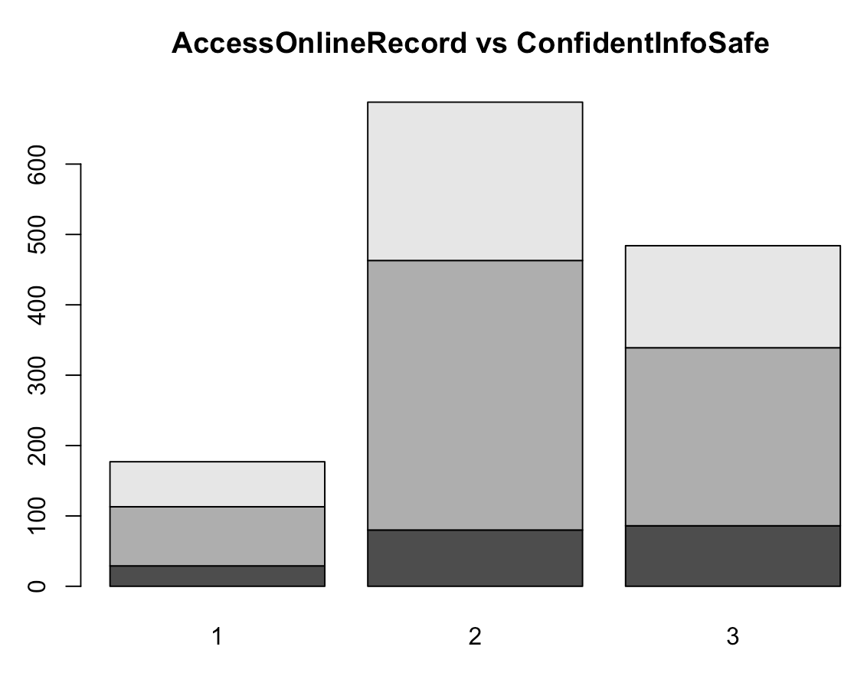
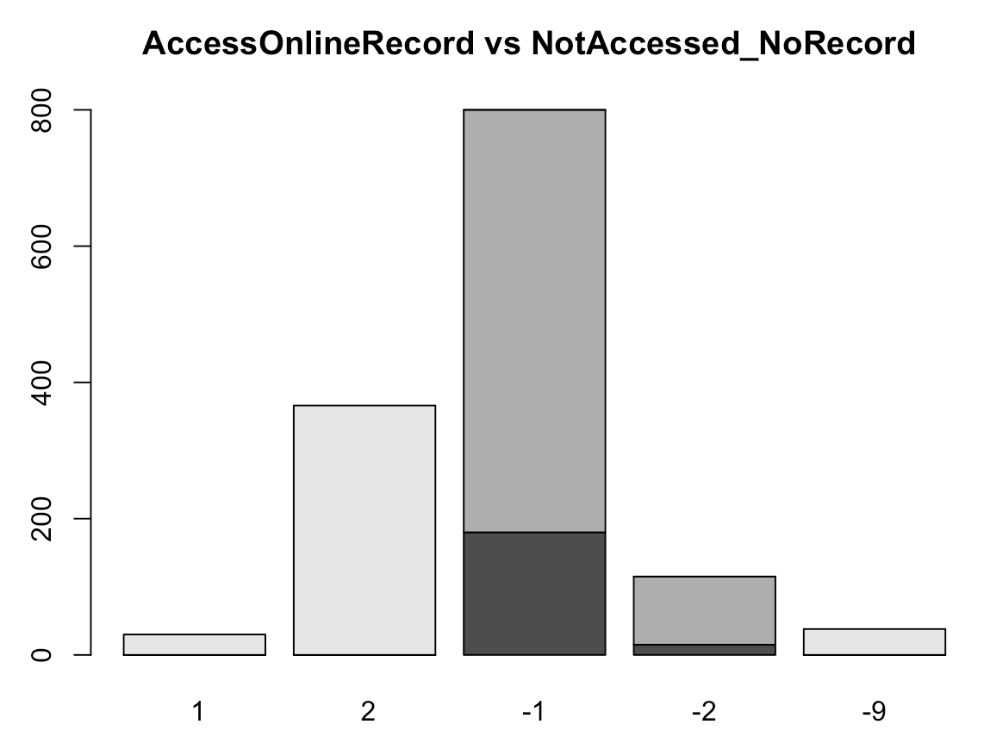
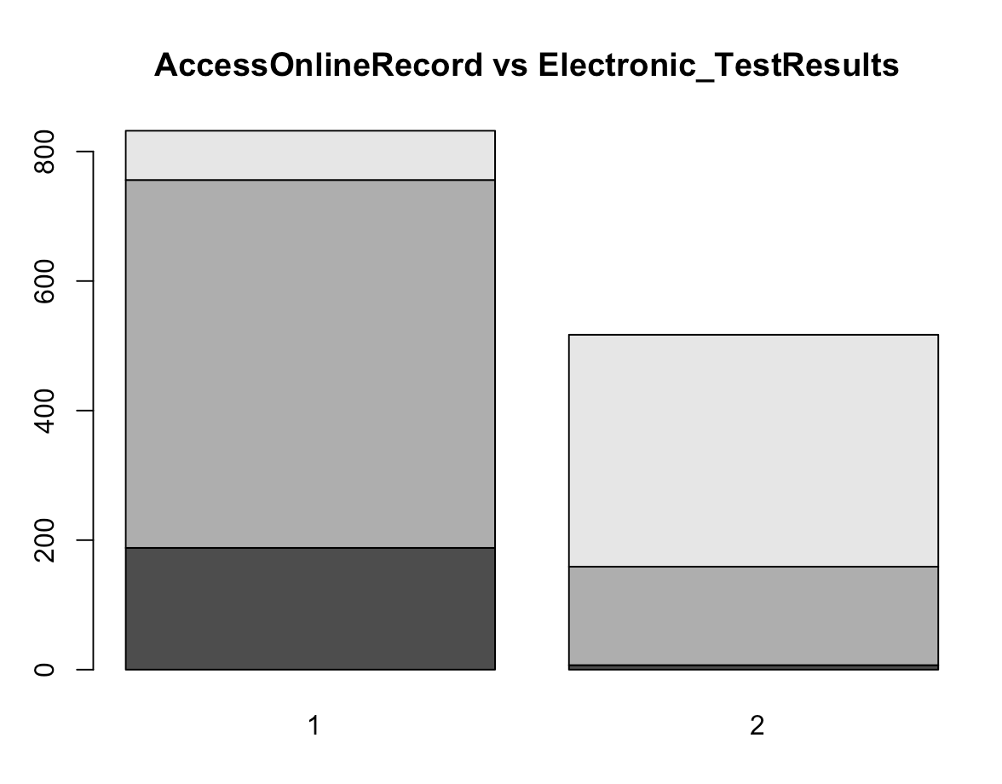
Bivariate Analysis
We can observe that people who never accessed online records also used a computer, smart phone, or other electronic means to look up medical test results and to communicate with the doctor.
People of the age 35-64 access the online records the most.
The highest grade of schooling completed by users is at least College for most of them.
83% of the users are confident that their medical records are safe.
Frequent
Less Frequent
Never

Slide 8
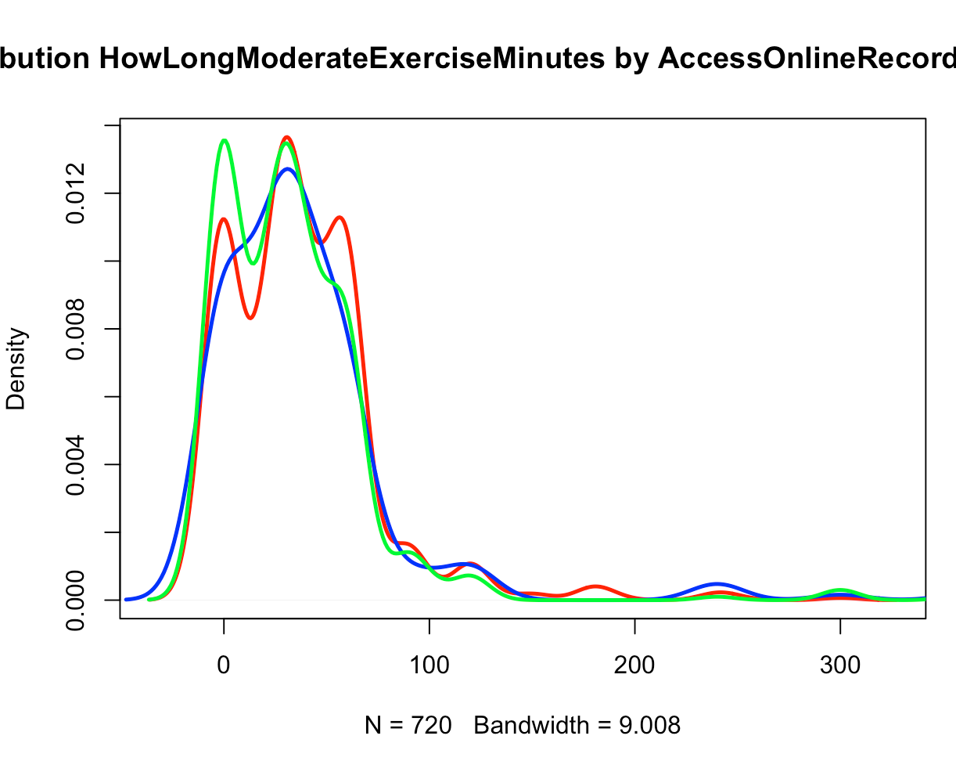
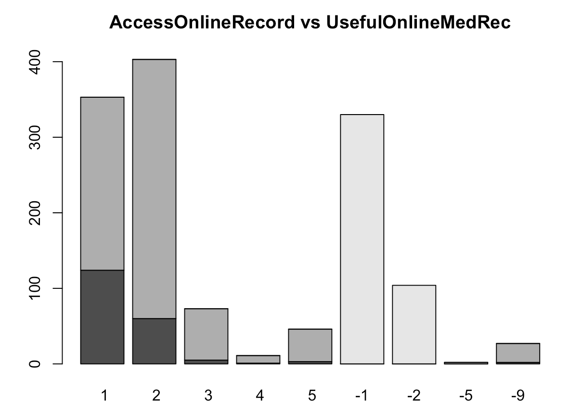
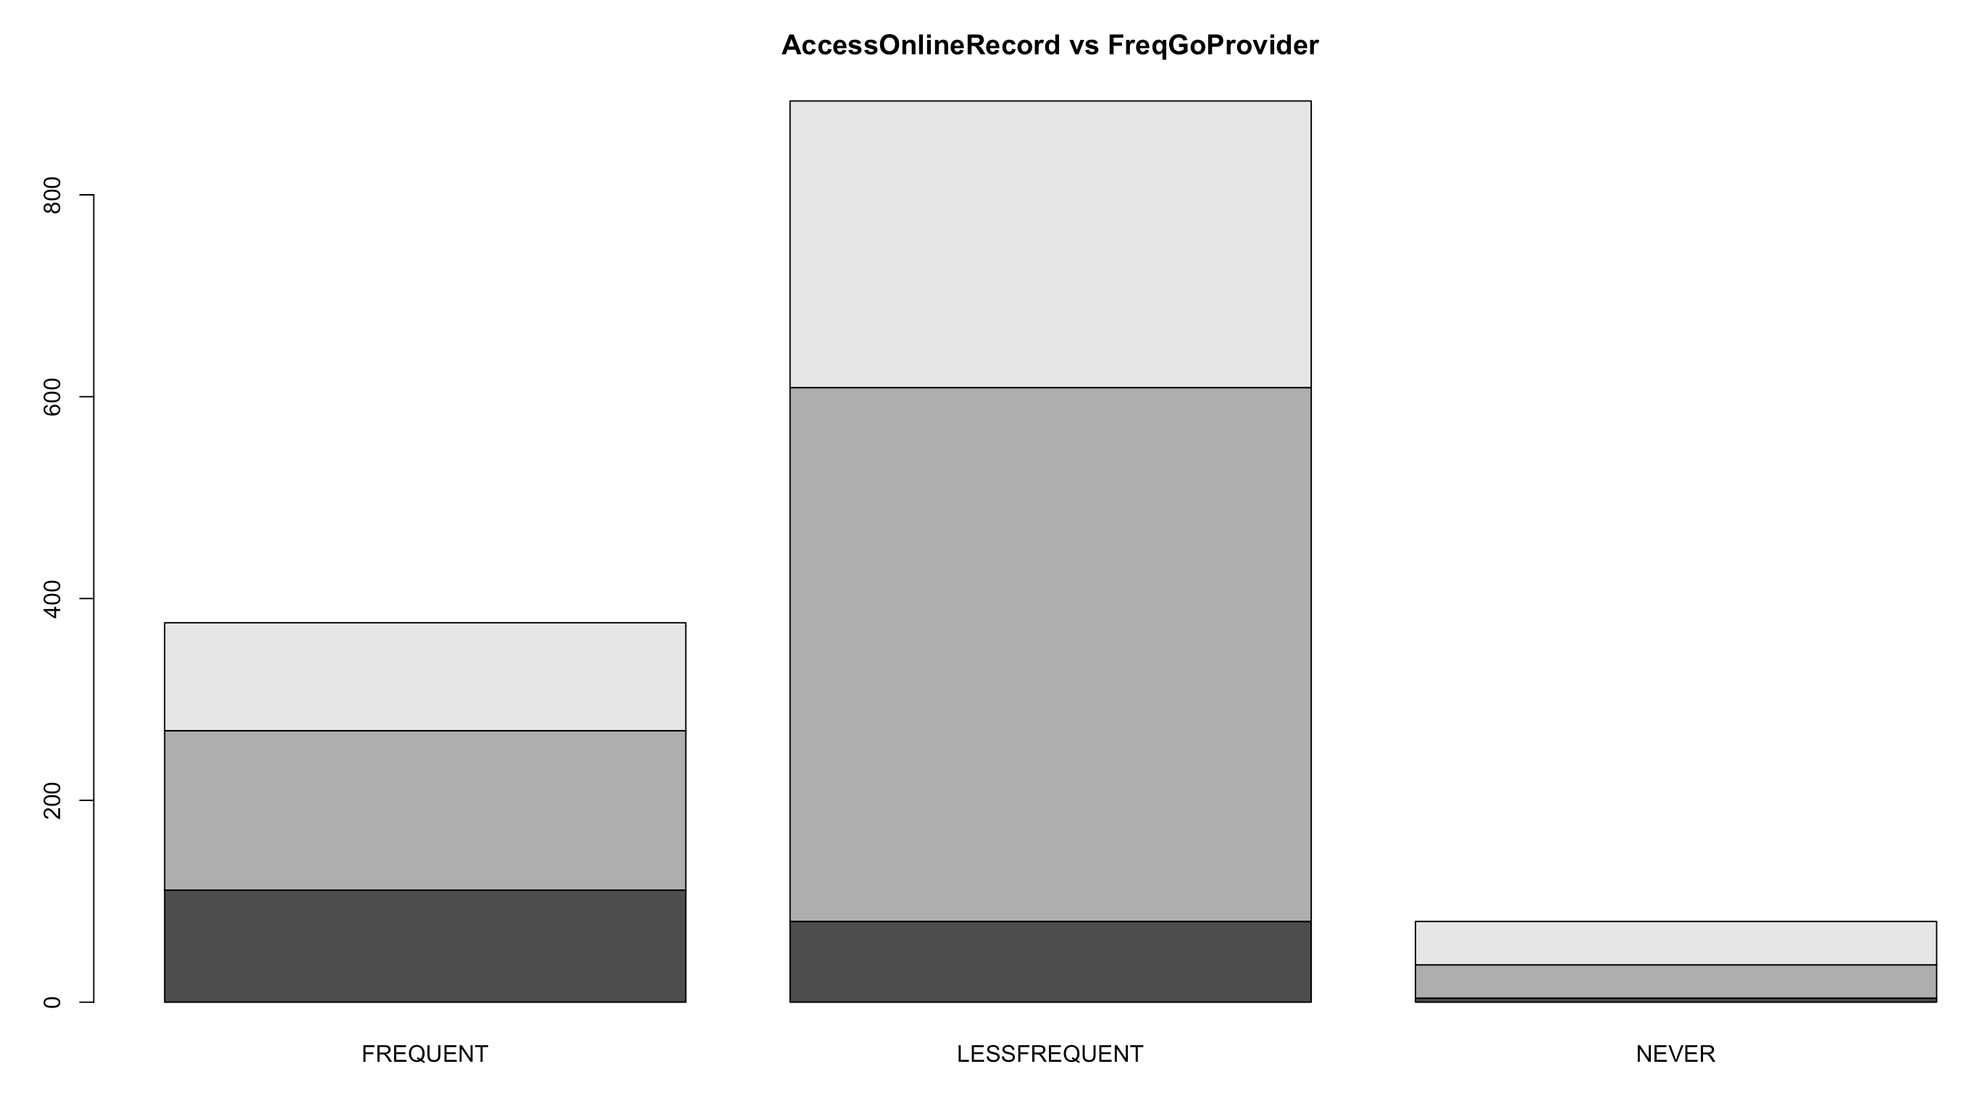
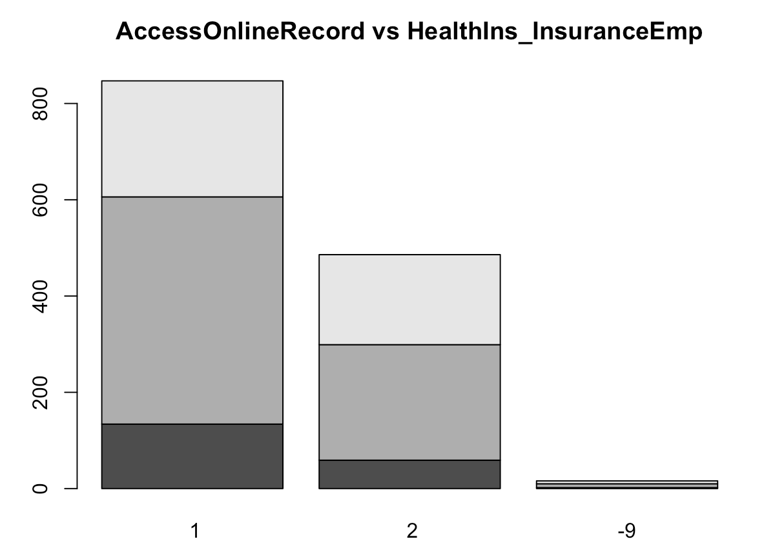
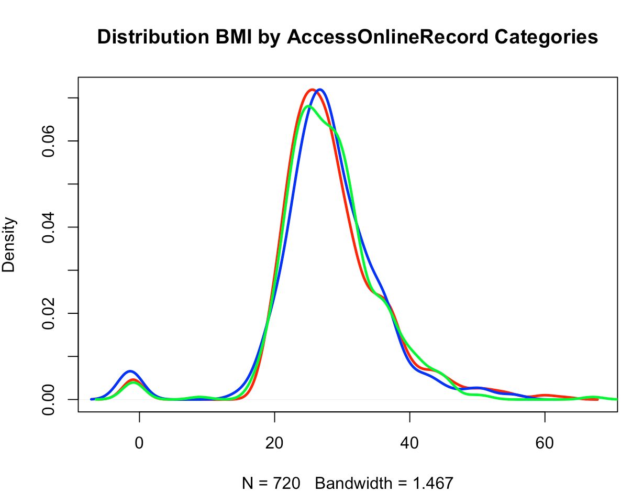
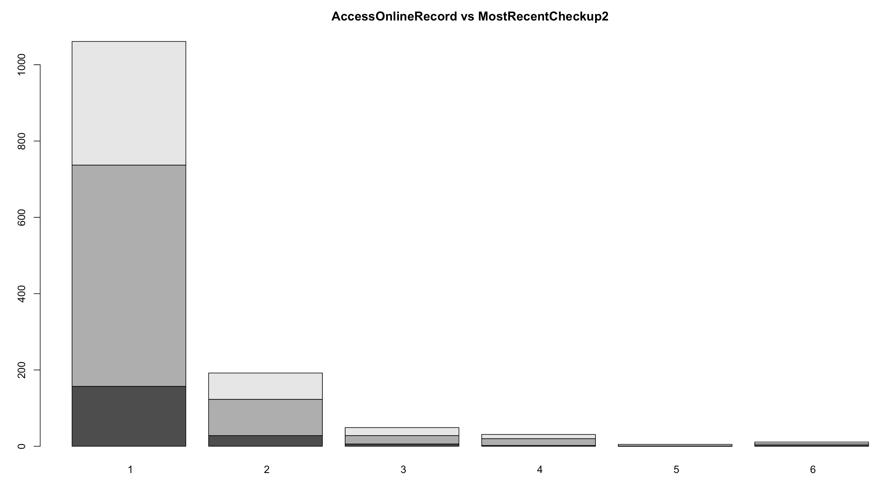
The users generally exercise 1-5 days and for less than an hour approximately.
People who access online records generally have a BMI within the range 20—40.
Users have visited their doctor for a routine checkup 1 or 2 years ago.
Most users have visited a doctor, nurse, or other health professional 1-4 times to get care for themselves.
People who access their online medical record find it very useful to monitor their health. Which indicates that the online medical records are efficient and this cannot be the reason why people do not access their online records.
Accessing the online record depends if they have an Insurance through an employer/ if they have purchased an insurance directly.

Slide 9
Random Forest Models

Slide 10
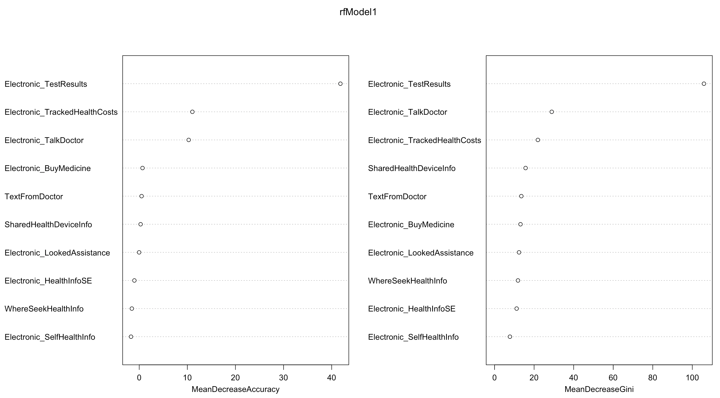
Usage of Internet to Seek Health Info
Important Variables are:
Electronic_TestResults
Electronic_TalkDoctor
Electronic_TrackedHealthCosts
SharedHealthDeviceInfo
Electronic_BuyMedicine

Slide 11
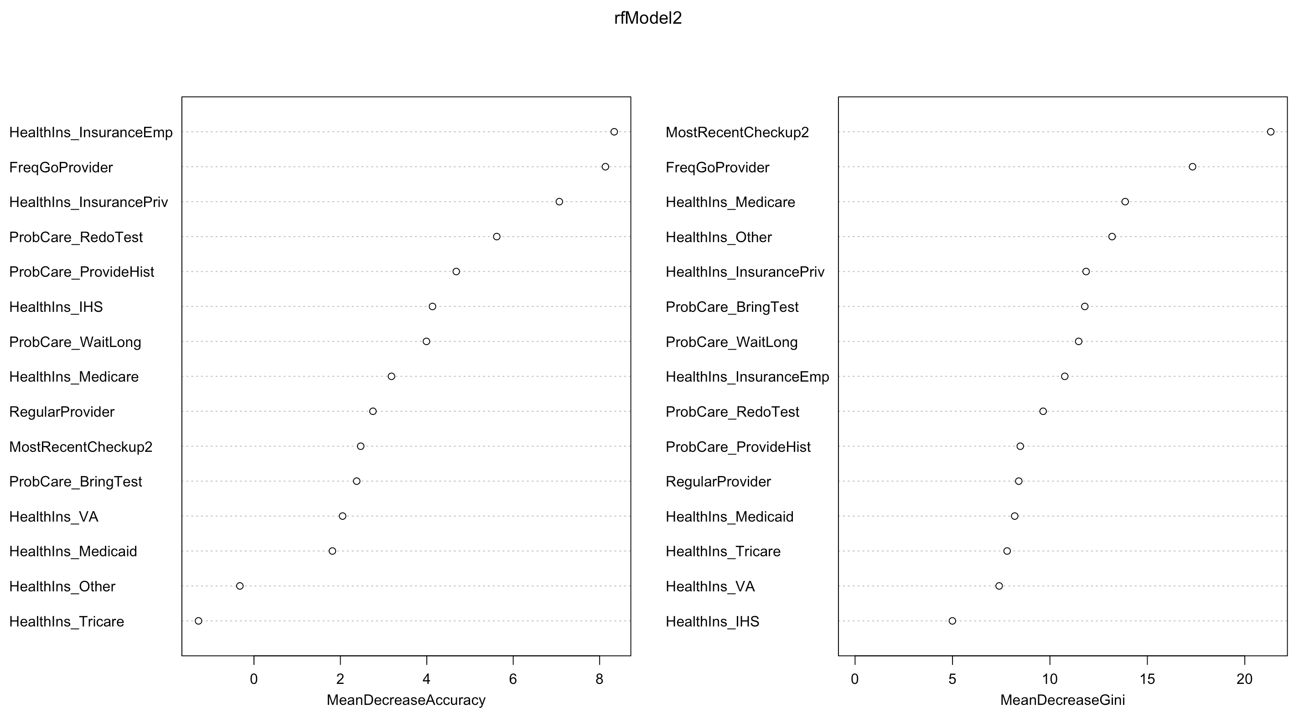
Health Care-Info about visiting a doctor
Important Variables are:
MostRecentCheckup2
FreqGoProvider
HealthIns_InsuranceEmp
HealthIns_InsurancePriv

Slide 12
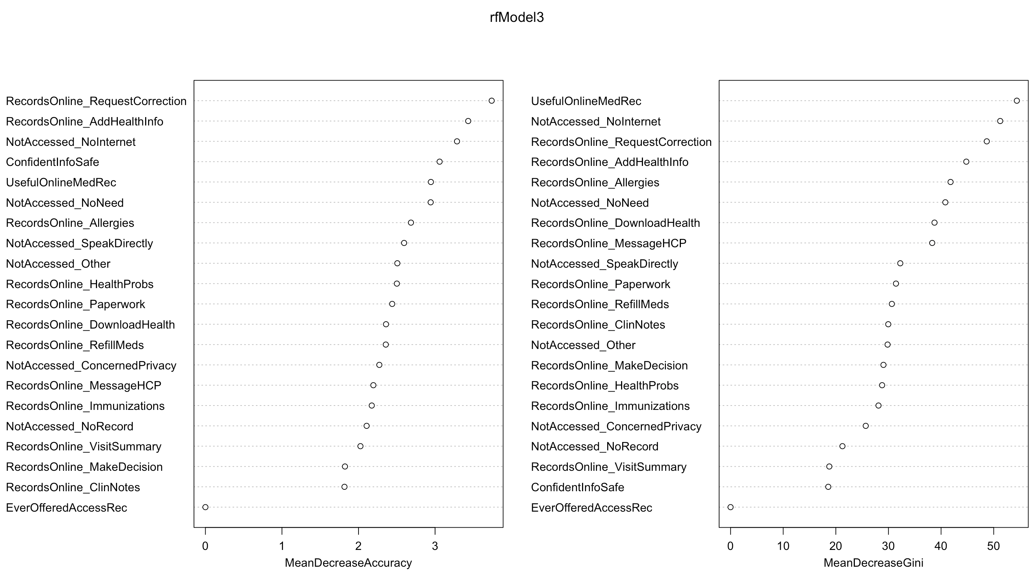
Medical Records
Important Variables are:
UsefulOnlineMedRec
NotAccessed_NoRecord
RecordsOnline_RequestCorrection
RecordsOnline_AddHealthInfo
ConfidentInfoSafe
RecordsOnline_Allergies

Slide 13
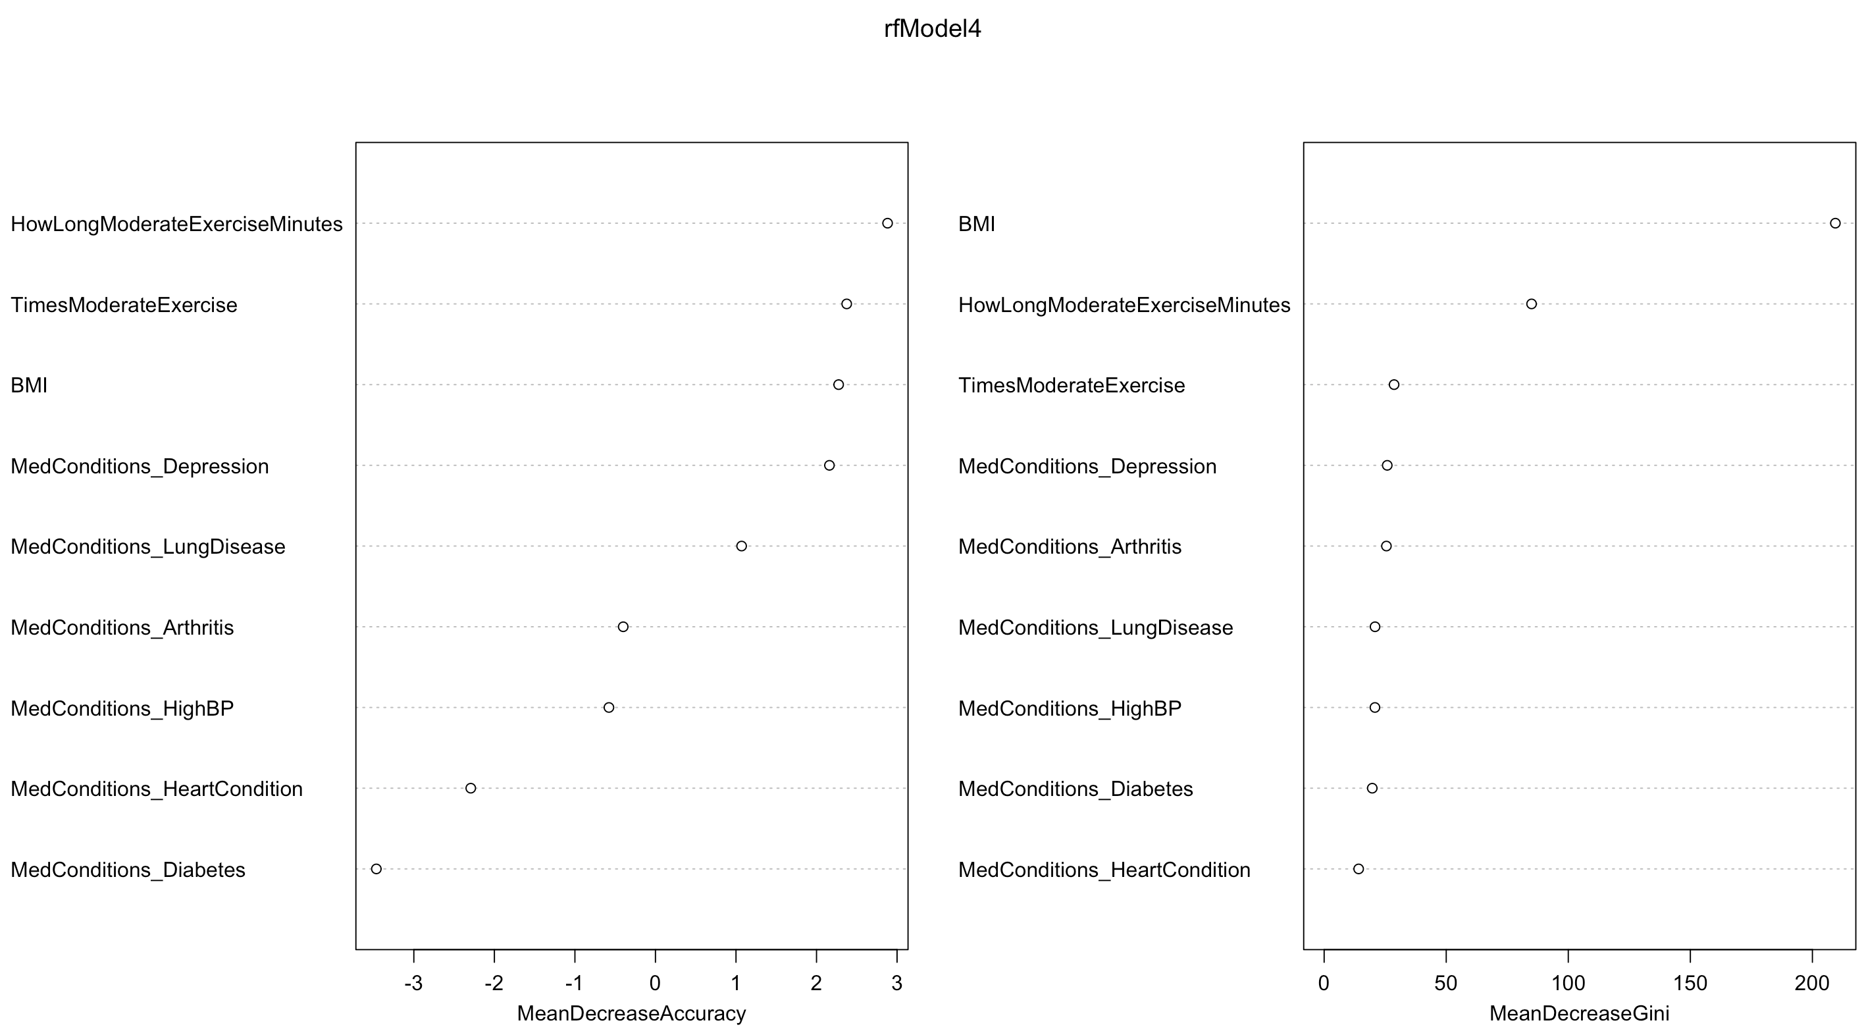
Overall Patient Health & Physical Activity
Important Variables are:
HowLongModerateExerciseMinutes
BMI
TimesModerateExercise

Slide 14
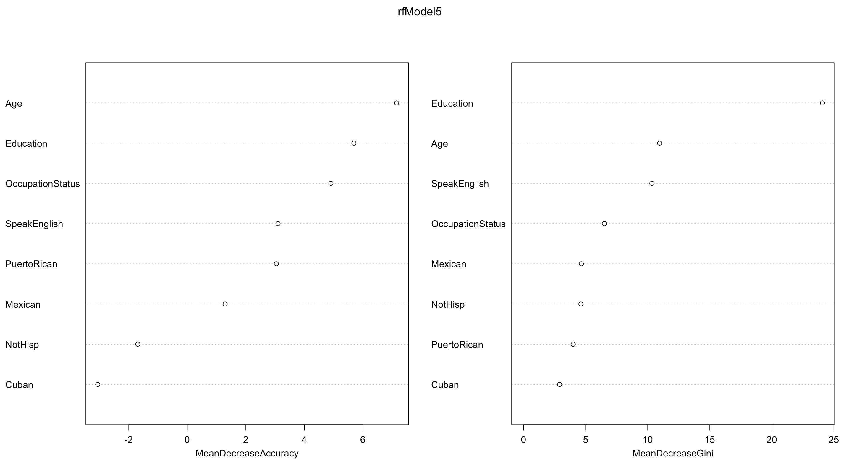
Personal Health
Important Variables are:
Age
OccupationStatus
Education
SpeakEnglish

Slide 15
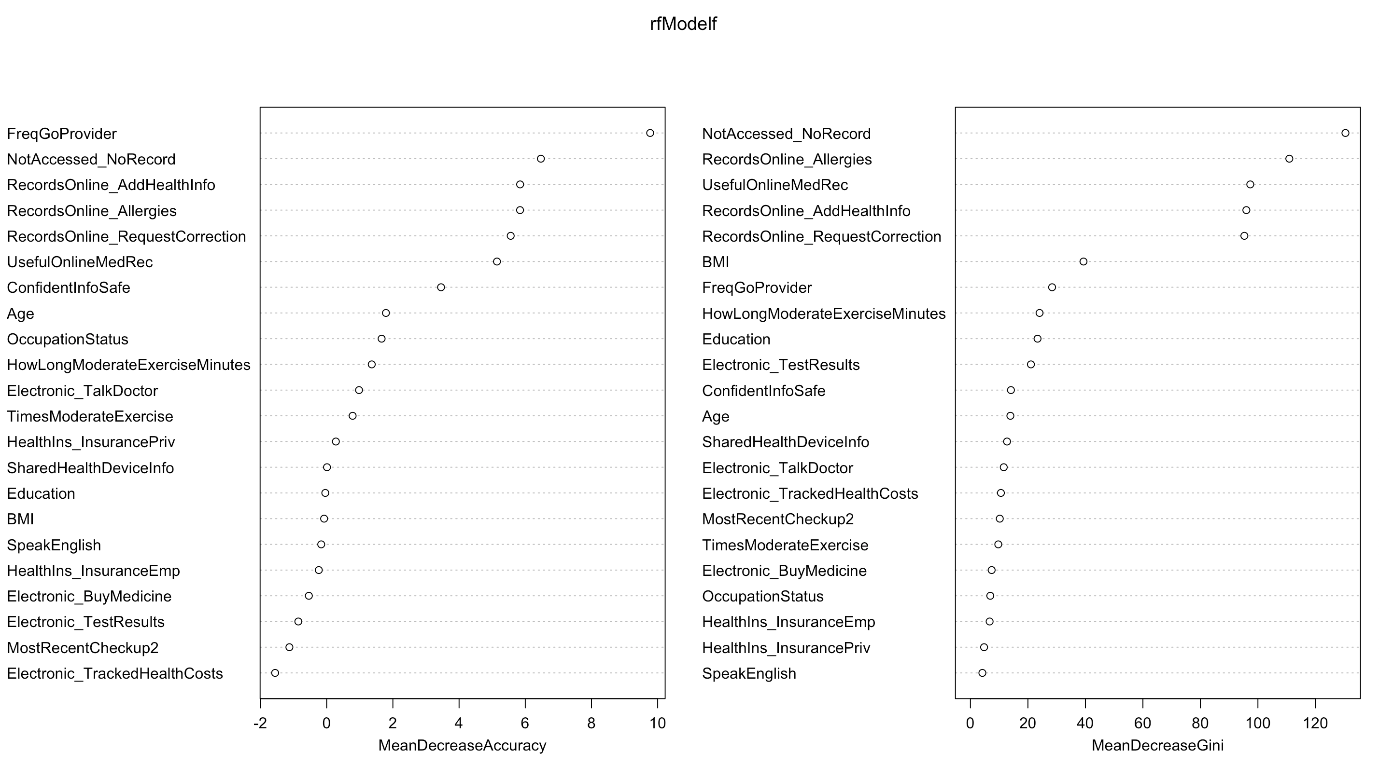
Final Model with all the important variables from 5 blocks

Slide 16
Factors influencing the accessing of online records
Health Care-Info About
Visiting a Doctor
MostRecentCheckup2
FreqGoProvider
HealthIns_InsuranceEmp
HealthIns_InsurancePriv
Usage of Internet to
Seek Health Info
Medical Records
Electronic_TestResults
Electronic_TalkDoctor
Electronic_TrackedHealthCosts
SharedHealthDeviceInfo
Electronic_BuyMedicine
UsefulOnlineMedRec
NotAccessed_NoRecord
RecordsOnline_RequestCorrection
RecordsOnline_AddHealthInfo
ConfidentInfoSafe
RecordsOnline_Allergies
Overall Patient Health & Physical Activity
Personal Health
HowLongModerateExerciseMinutes
BMI
TimesModerateExercise
Age
OccupationStatus
Education
SpeakEnglish

Slide 17
Thank You

